Slide 1
Various Bayesian Probability Stuff
Travis Asher

Slide 2
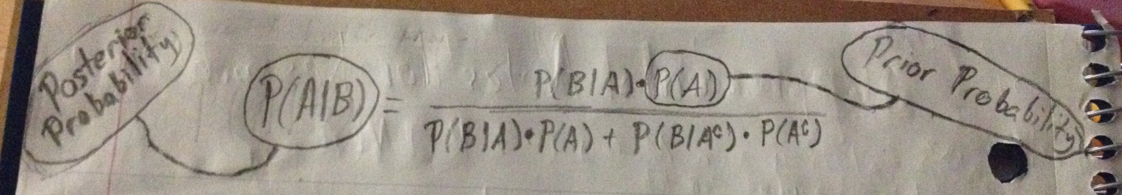
Prior and Posterior Probability
Prior Probability
Information known before an experiment takes place
Aka a priori probability
If inference is desired on some event A, then:
Probability of event A is P(A)
P(A) is the prior probability
Posterior Probability
Information obtained by updating prior information from an experiment
Is a conditional probability
If event B is event representing the results of some experiment, then:
Updated probability of event A is conditional on event B having occurred: P(A|B)
P(A|B) is the posterior probability

Slide 3
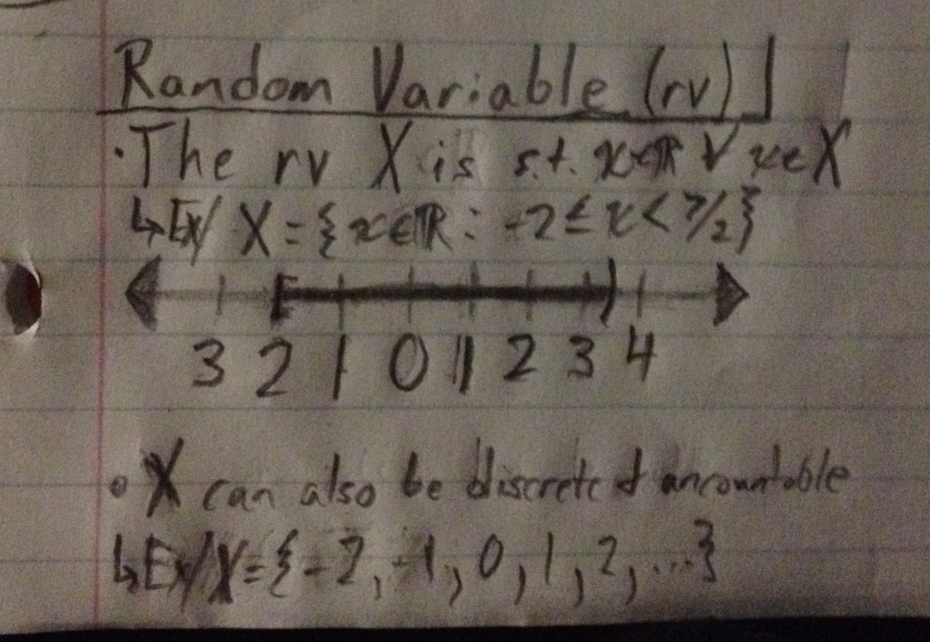
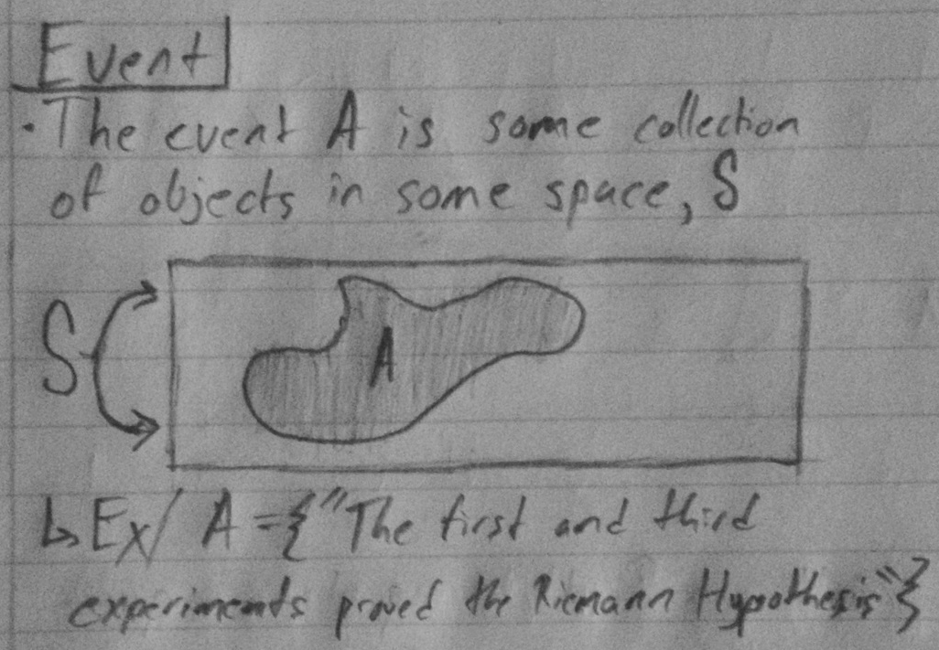
Clarifying the Textbook’s Notation for Probability
Probability of a Random Variable
Consider some random variable X
To speak of the probability of X, our book would write: p(X)
Probability of an Event
Consider some event A
To speak of the probability of A, our book would write: Pr(A)

Slide 4
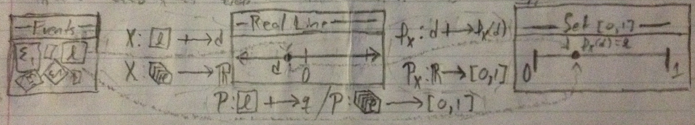
Clarifying the Textbook’s Notation for Probability (Cont.)
Q: Cool, now why? Although seemingly arbitrary, this is done for good reason.
Random Variable vs Event
Both objects are very different from each other:
Random variables are sets containing elements from the real number line (THINK: RVS ARE NUMBERS)
Events are just sets; that is, events are some collection of any general thing (THINK: EVENTS ARE ANYTHING AT ALL)
Illustrations of random variables and events are provided on the previous page
However, they are related: a random variable is simply a mapping of each element of an event to a distinct number in the real number line (see figure below for more details)
The general idea illustrated in the above figure is that the notion of “probability” is a mapping from a space to some value between 0 and 1; here, space can refer to either a space of events or a space of random variables. To make use of the concept of random variables, you bifurcate the direct mapping from the space of events to the space of probabilities (which is: Pr: A -> [0,1] ) into two mappings: the map X: A -> R (where ‘R’ is the real number line) and the map p: R -> [0,1]. Thus, the mapping Pr(A) = p(X(A)) = (p∘X)(A), where (p∘X): A -> [0,1].
*NOTE: The above notation does not use the R-INLA textbook’s conventions of p versus Pr, as it was written by me for use in a different statistics class. However, all ‘P’s and ‘ρ’s with the subscript X above would be written as p(•) in the INLA textbook’s notation; the ‘P’s above sans subscript would correspond to Pr(•) in the INLA textbook’s notation.

